Slide 1
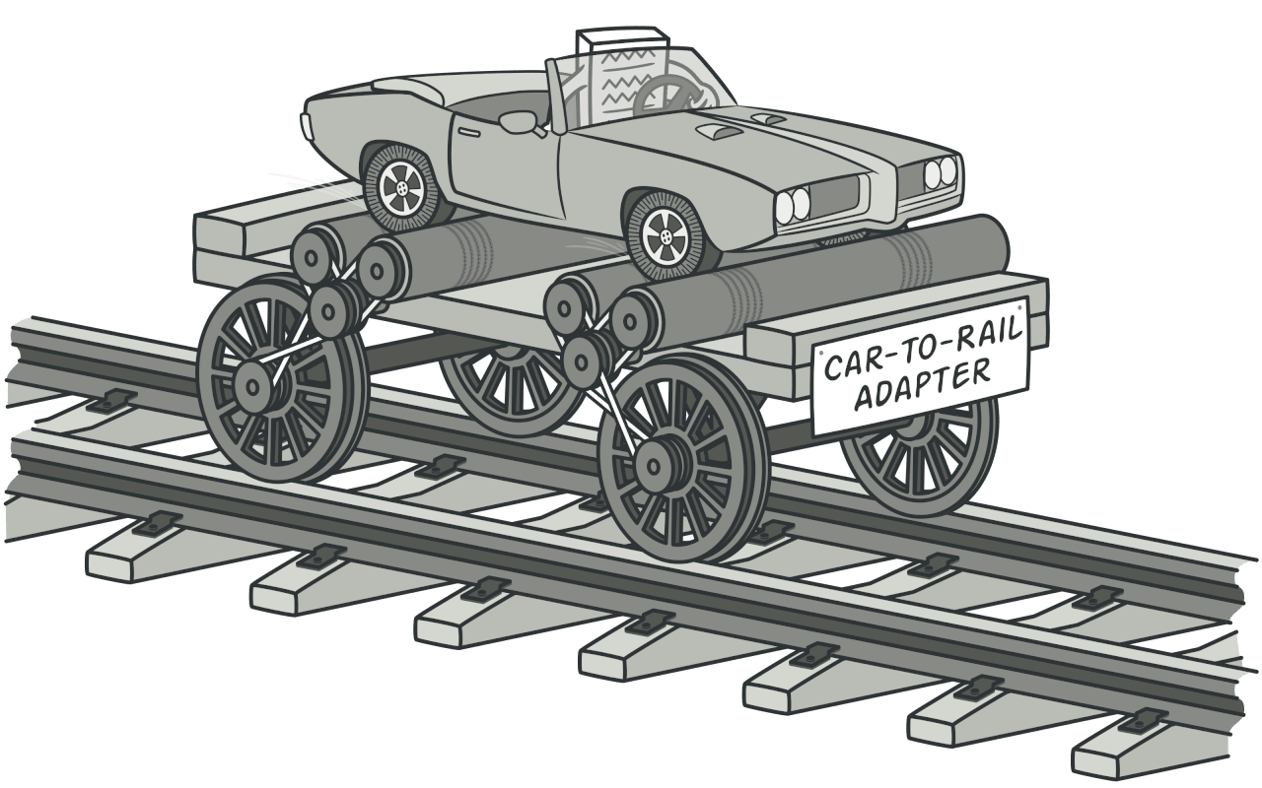
1. Adapter
Notes:
Adapter is a structural design pattern that allows objects with incompatible interfaces to collaborate.

Slide 2
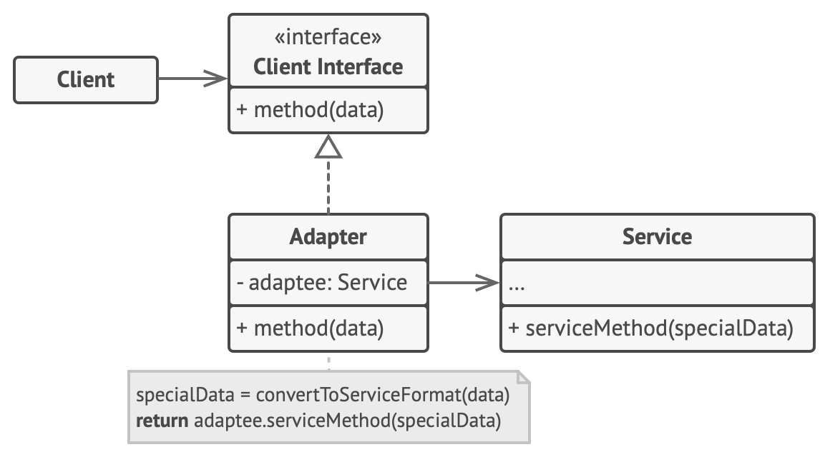
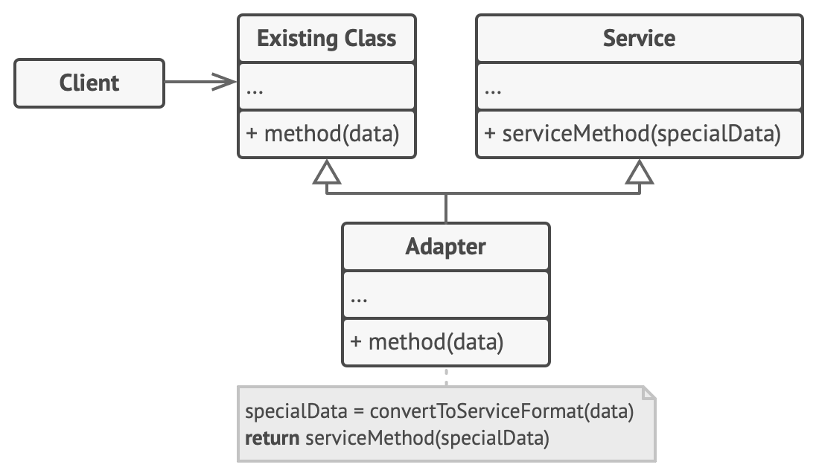
Target
Adaptee
Adapter
Object Adapter
Class Adapter

Slide 3
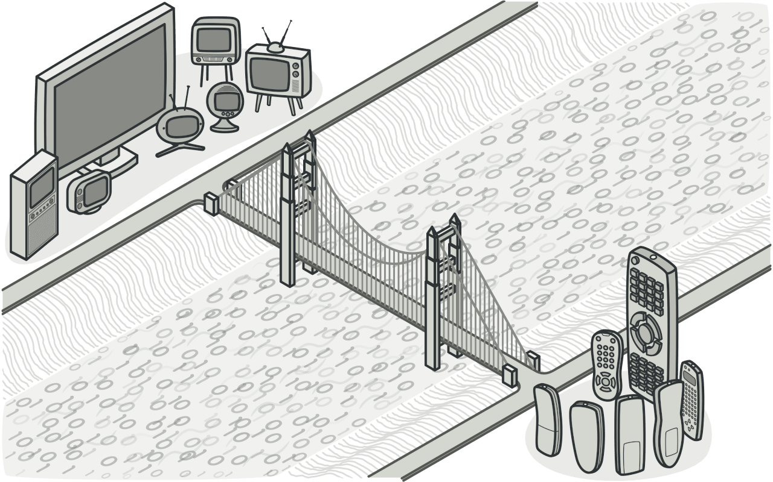
2. Bridge
Notes:
Bridge is a structural design pattern that lets you split a large class or a set of closely related classes into two separate hierarchies—abstraction and implementation—which can be developed independently of each other.

Slide 4
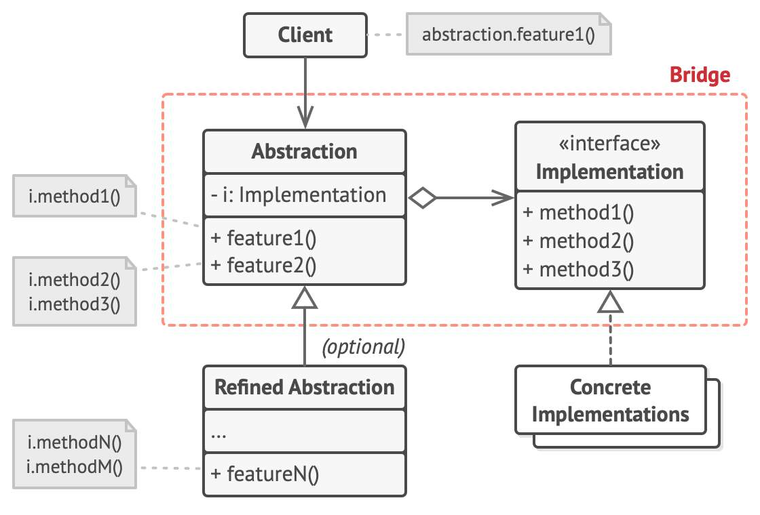
Abstraction
Refined Abstraction
Implementation
Concrete Implementations

Slide 5
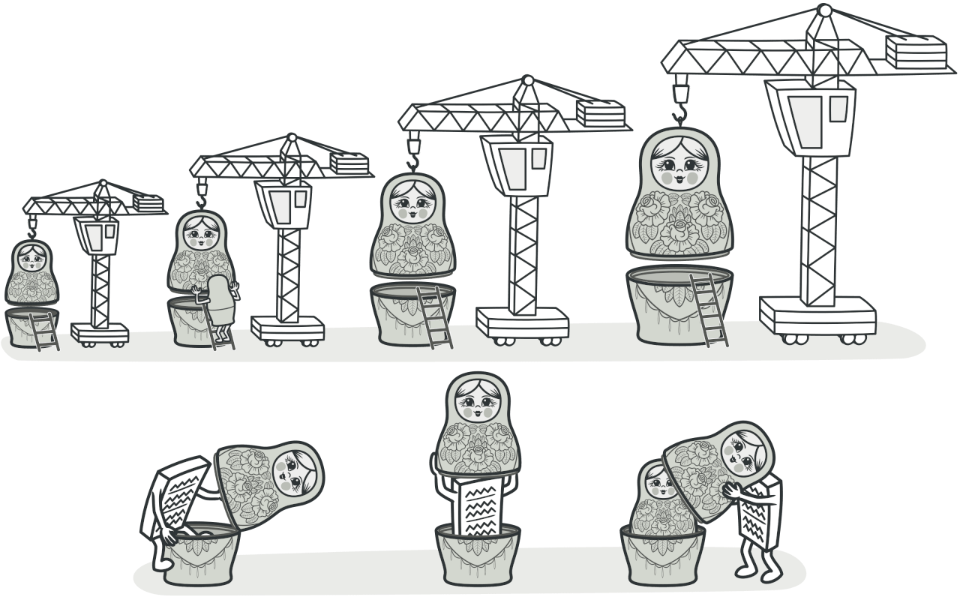
3. Decorator
Notes:
Decorator is a structural design pattern that lets you attach new behaviors to objects by placing these objects inside special wrapper objects that contain the behaviors.

Slide 6
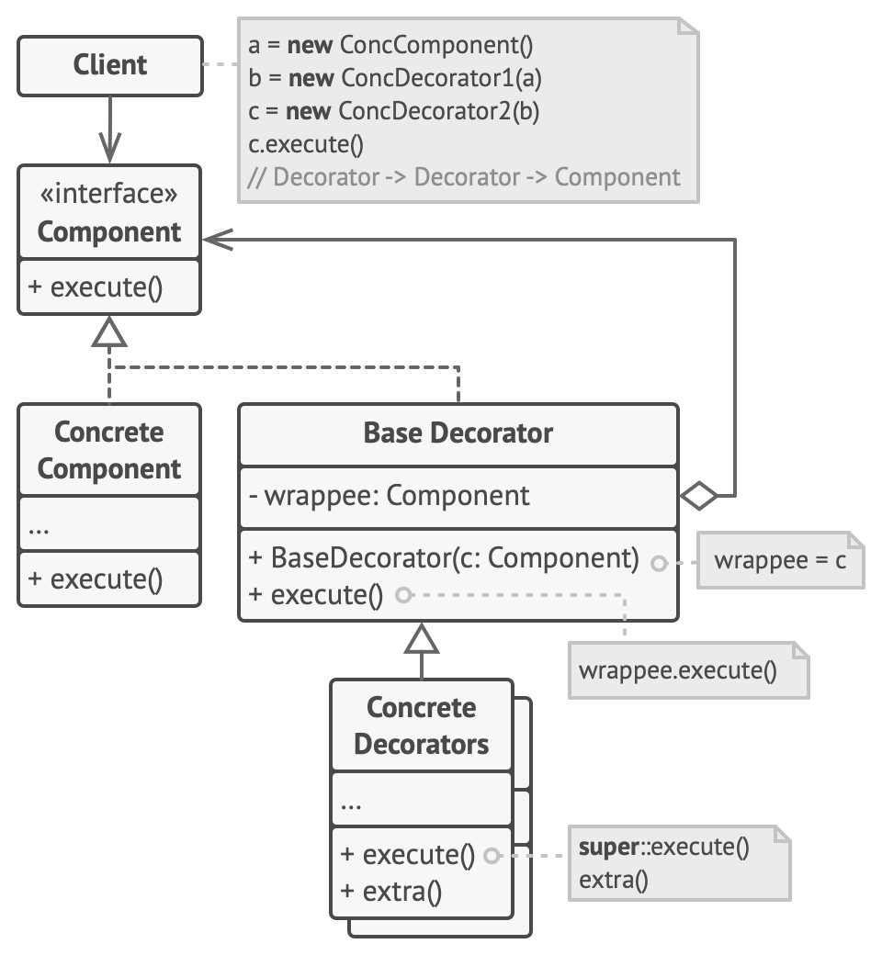
Component
ConcreteComponent
Decorator
ConcreteDecorator

Slide 7
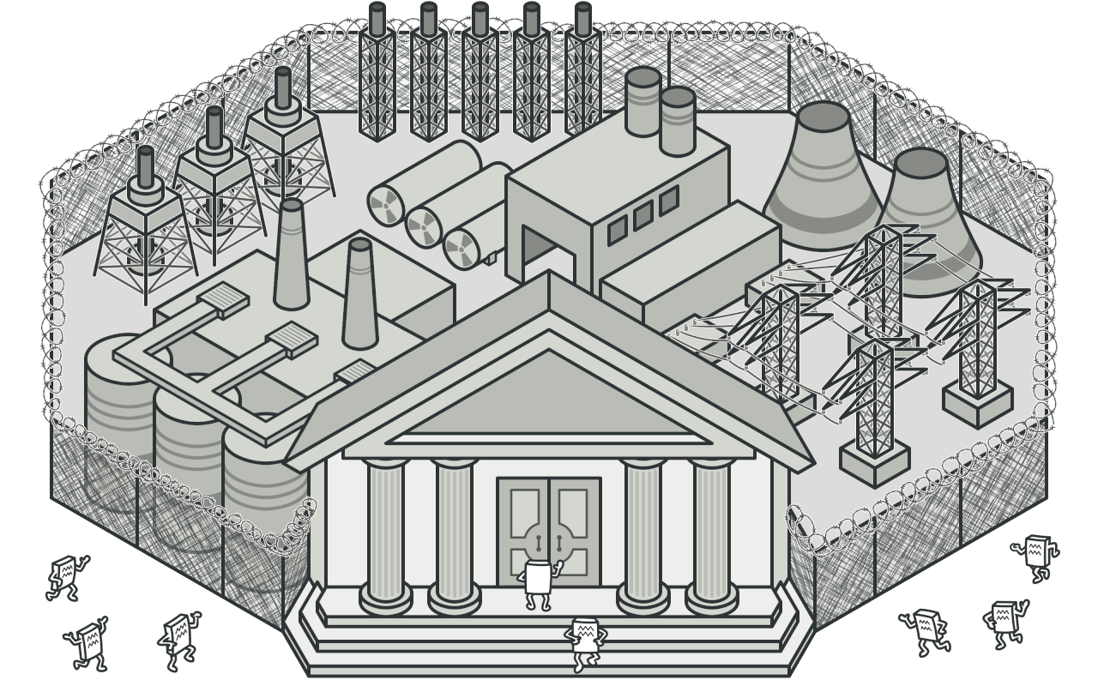
4. Facade
Notes:
Facade is a structural design pattern that provides a simplified interface to a library, a framework, or any other complex set of classes.

Slide 8
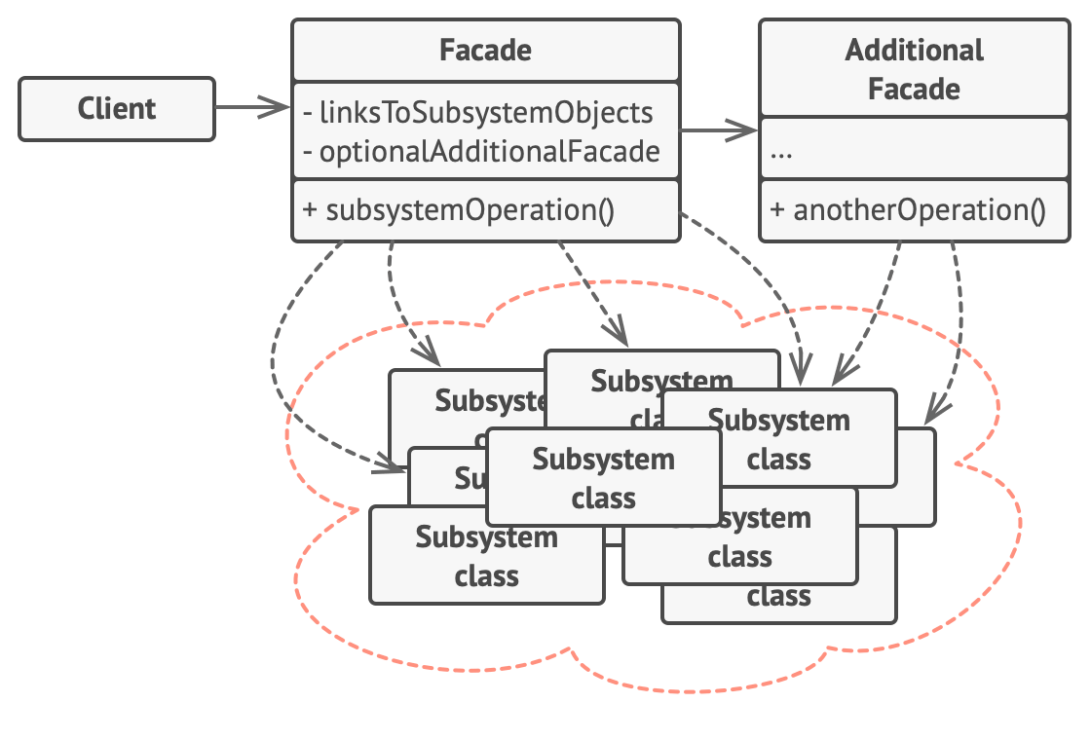
Facade
SubSystem

Slide 9
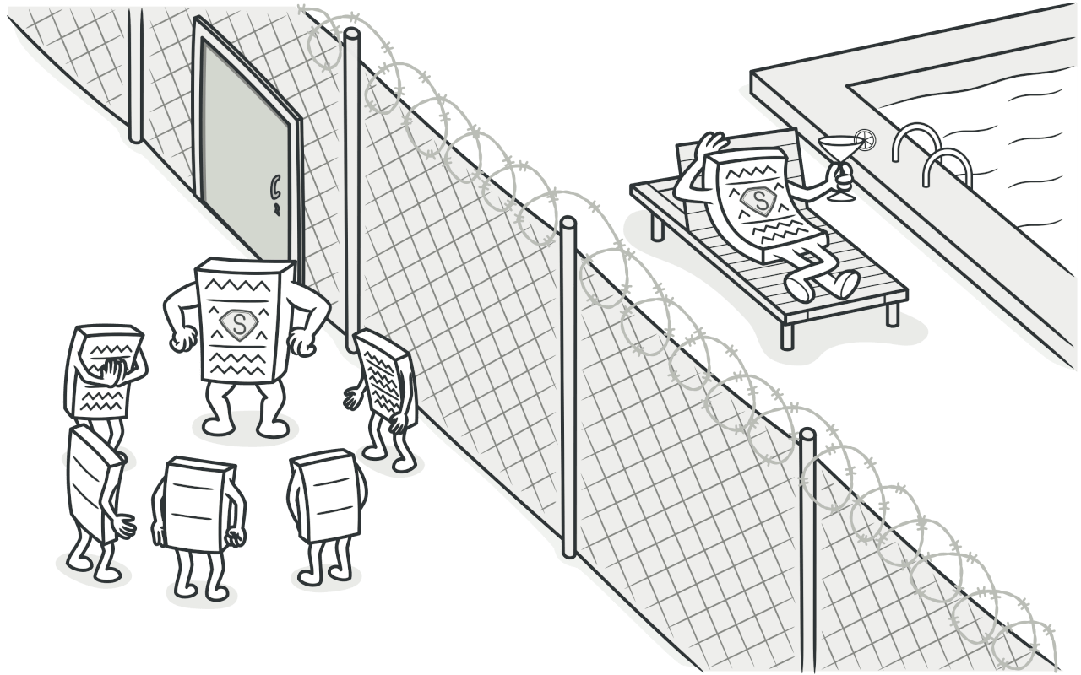
5. Proxy
Notes:
Proxy is a structural design pattern that lets you provide a substitute or placeholder for another object. A proxy controls access to the original object, allowing you to perform something either before or after the request gets through to the original object.

Slide 10
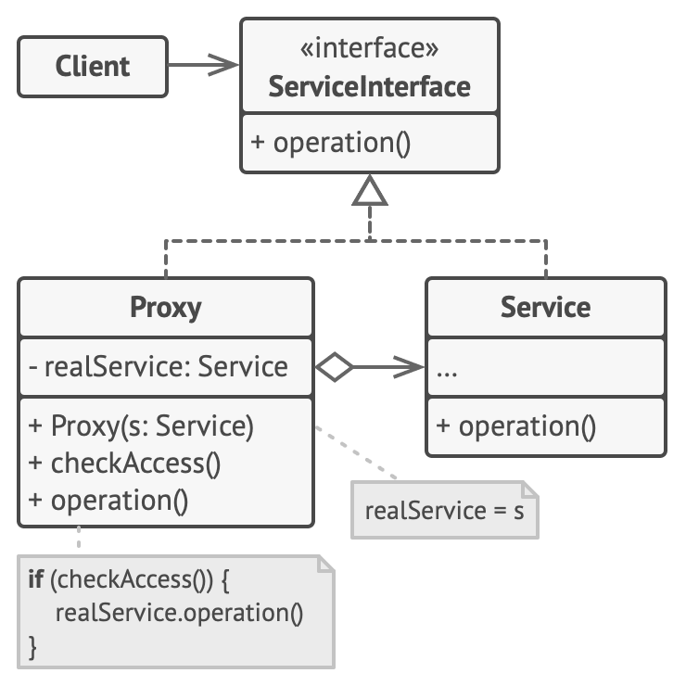
Subject
RealSubject
Proxy

